Slide 1
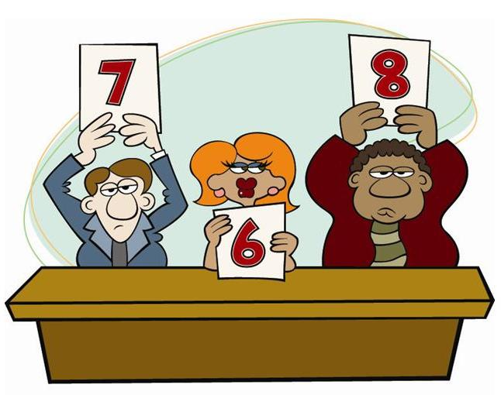
Rate My Traits

Slide 2
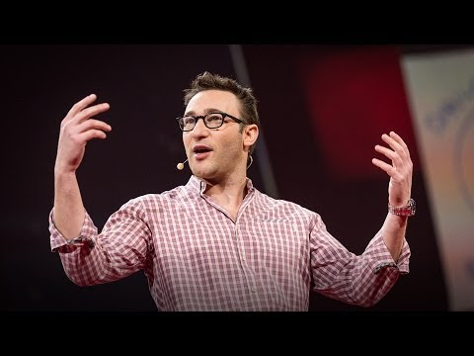

Slide 3
Write down your top ten traits from Simon Sineck

Slide 4
Highlight on the document which ones you listed

Slide 5
Rate My Traits

Slide 6

Creative thinking—The ability or power used to produce original thoughts and ideas based upon reasoning and judgment.

Slide 7
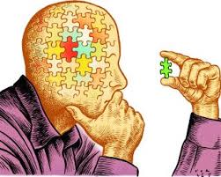
2. Critical thinking—The ability to acquire information, analyze and evaluate it, and reach a conclusion or answer by using logic and reasoning skills.

Slide 8
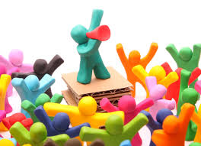
3. Communication—The successful transmission of information through a common system of symbols, signs, behavior, speech, writing, or signals.

Slide 9

4. Decision making—The act of examining several possible behaviors and selecting from them the one most likely to accomplish the individual’s or group’s intention. Cognitive processes such as reasoning, planning, and judgment are involved.

Slide 10
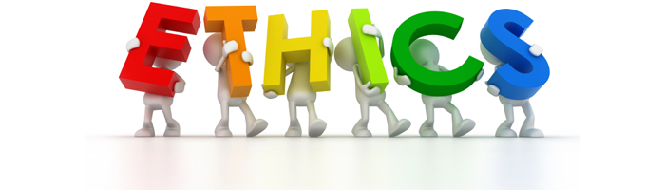
5. Ethics—Conforming to an established set of principles or accepted professional standards of conduct.

Slide 11
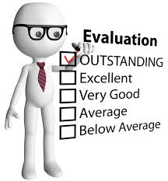
6. Evaluation—1.The collection and processing of information and data in order to determine how well a design meets the requirements and to provide direction for improvements. 2. A process used to analyze, evaluate, and appraise, a student’s achievement, growth, and performance through the use of formal and informal techniques.

Slide 12
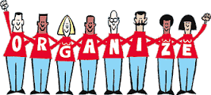
7. Organization—The act or process of organizing or being organized. Good organization will not only ensure success of a program, but without it, the success can be limited or fail to materialize at all.

Slide 13
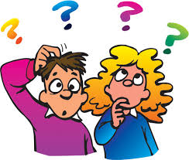
8. Problem solving—The process of understanding a problem, devising a plan, carrying out the plan, and evaluating the plan in order to solve a problem or meet a need or want.

Slide 14
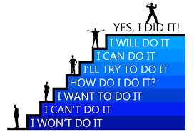
9. Self-esteem—A confidence and satisfaction in oneself and trusting one’s ability and instincts.

Slide 15
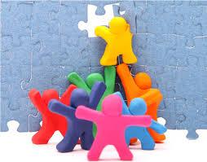
10. Teamwork—The process that allows individuals to pool their strengths in order to arrive at better solutions to problems, with all involved subordinating personal prominence to the efficiency of the whole.

Slide 16
4 personality traits of a leader
https://www.entrepreneur.com/article/245394

Slide 17
2 groups and create top ten traits

Slide 18
1 group and create top ten traits

Slide 19
How do we develop these traits?

